Slide 1

Trail formation
Michael Mattmann and Riccardo Schira

Slide 2
Introduction
Motivation: The planning of trails and streets in a park is an important issue in the planning of an entire park.
What we did: We have simulated some simple situation and tryed to explain the results of theme. In the second part we have taken some real parks and looked if the planning of them had been made in a good way, or if there’s a potential of improvement.

Slide 3
Fundamental questions
How do trajectories form?
What is the final network of the most common sets of entrance / exits?
How does topology influence the final network?
How would the system of trails of a real park change over time if the existing ”trails” will be no longer asphalted?

Slide 4
The Model 1
We considered:
Presence of trails
Slope of the ground
Regeneration of nature
Direction of target
We didn’t considered:
Social forces
Inertia of pedestrian

Slide 5
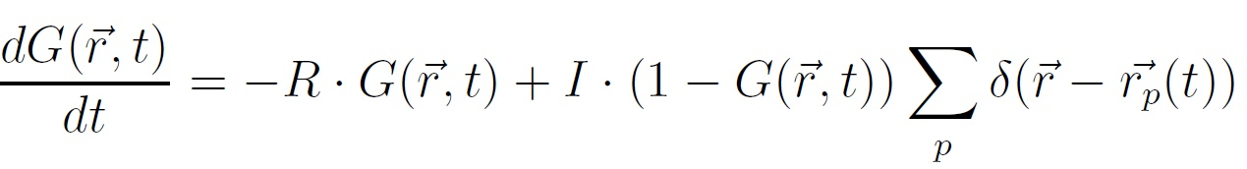
The Model 2
Equation of ground:
Regeneration of nature
Footprints left by pedestrians

Slide 6
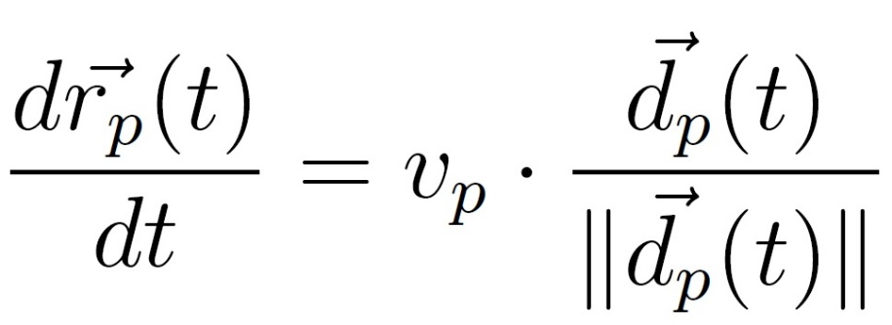
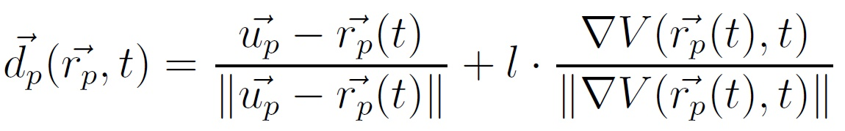
The Model 3
Equation of motion:
Direction of the target
Most comfortable direction

Slide 7
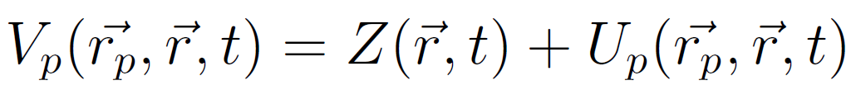
The Model 4
The potential:
Presence of tracks in the neighborhoods
‘Slope’ of the ground

Slide 8
Implementation 1
Discrete → Matrix:
Cells: 1x1m
Ground
Topolgy
Potential
Pedestrian position
Pedestrian: vector:
Entrance coordinate
Exit coordinate

Slide 9
Implementation 2
Scripts:
‘start.m’
‘main.m’
’insert_person_N_entrance_N_exit.m’
’direction_pend.m’
’move_person.m’
’change_ground.m’

Slide 10
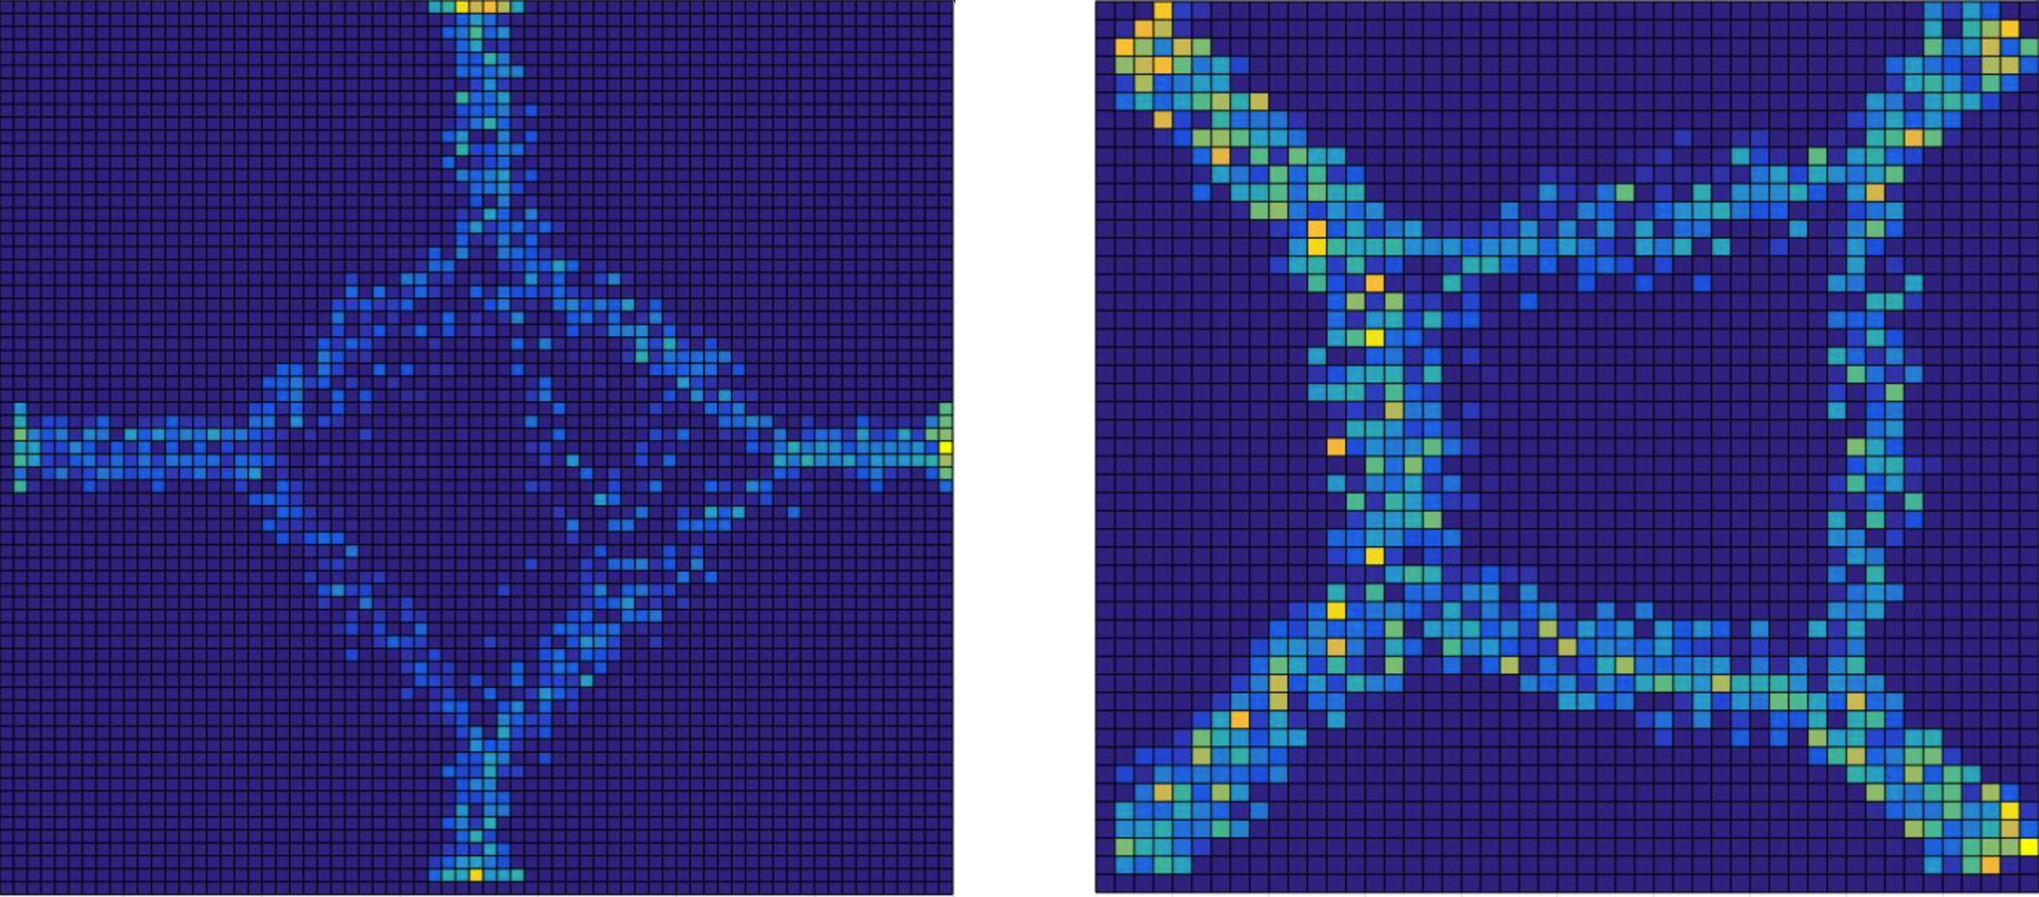
Most common set of entraces / exits

Slide 11
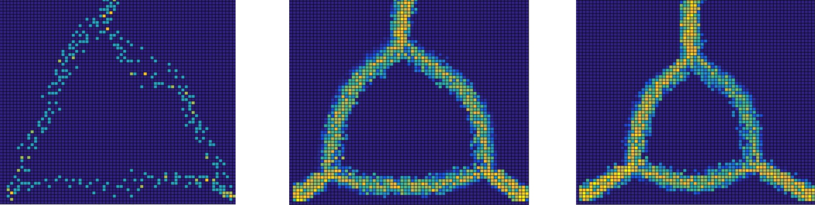
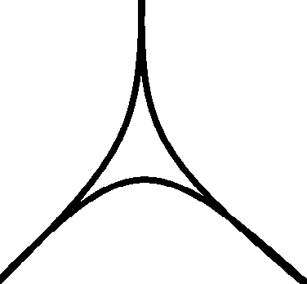
Most common set of entraces / exits
It was the only simulation that gave us a different result from what we expected.

Slide 12
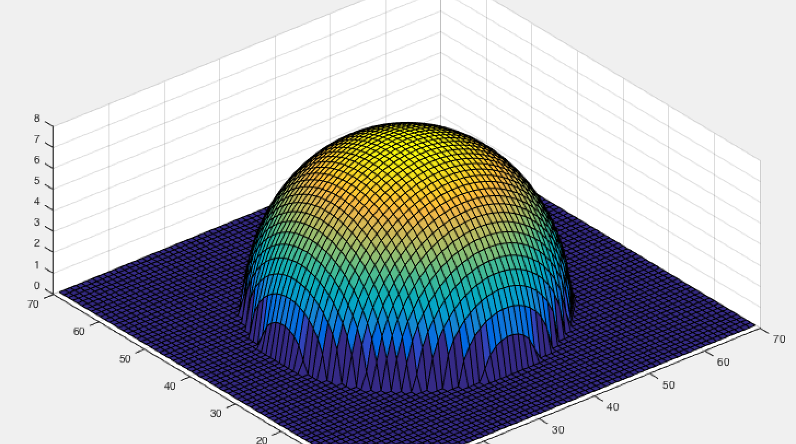
Some simulations with topology

Slide 13
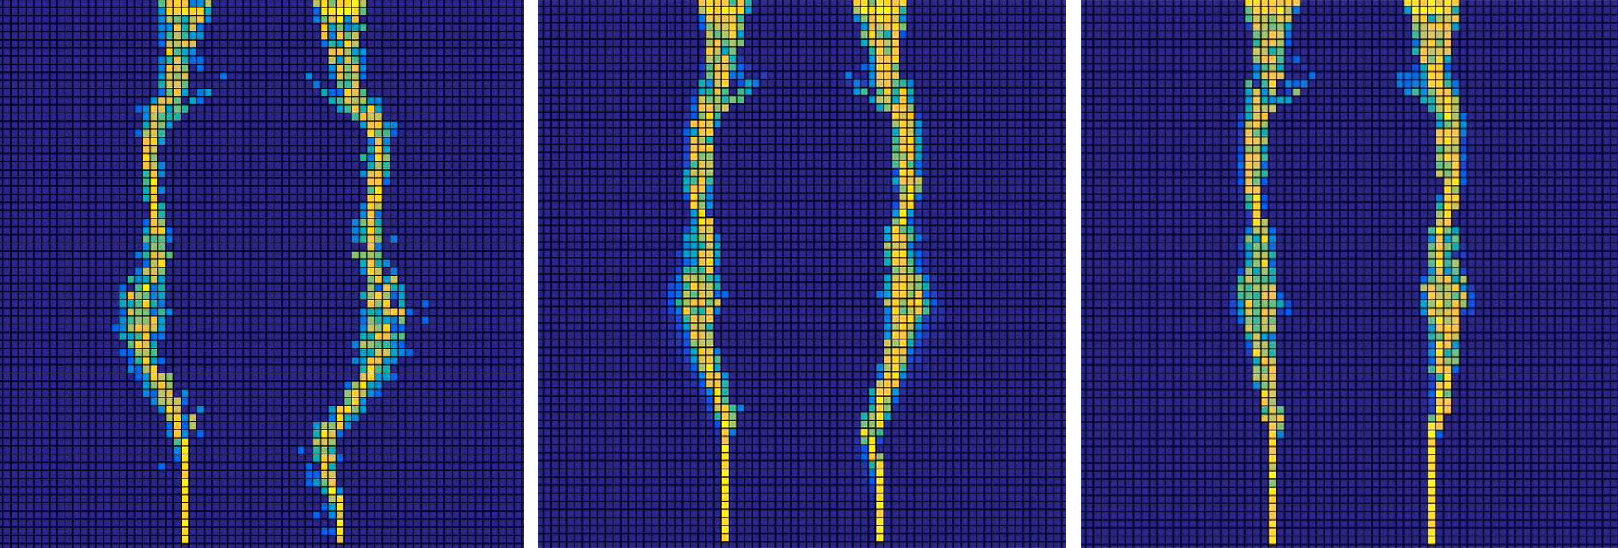
Some simulations with topology

Slide 14
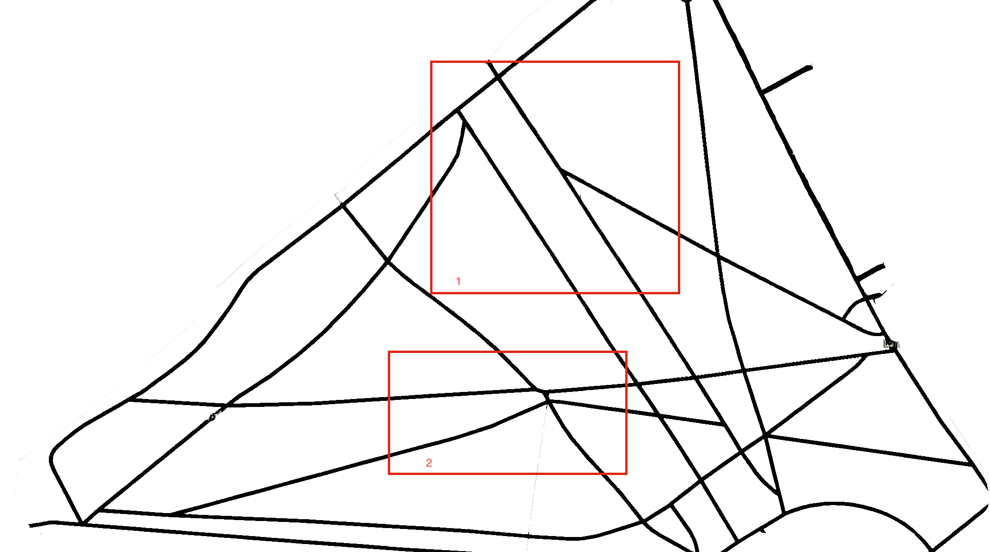
Real Park I: Green Park

Slide 15
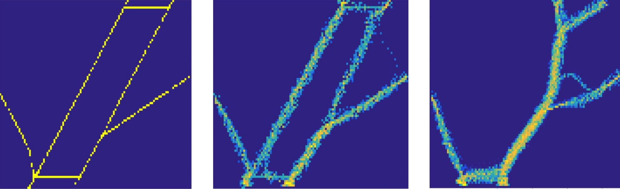
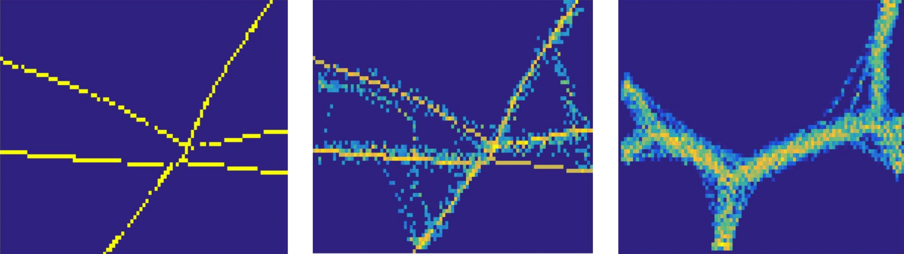
Real Park I: Green Park

Slide 16
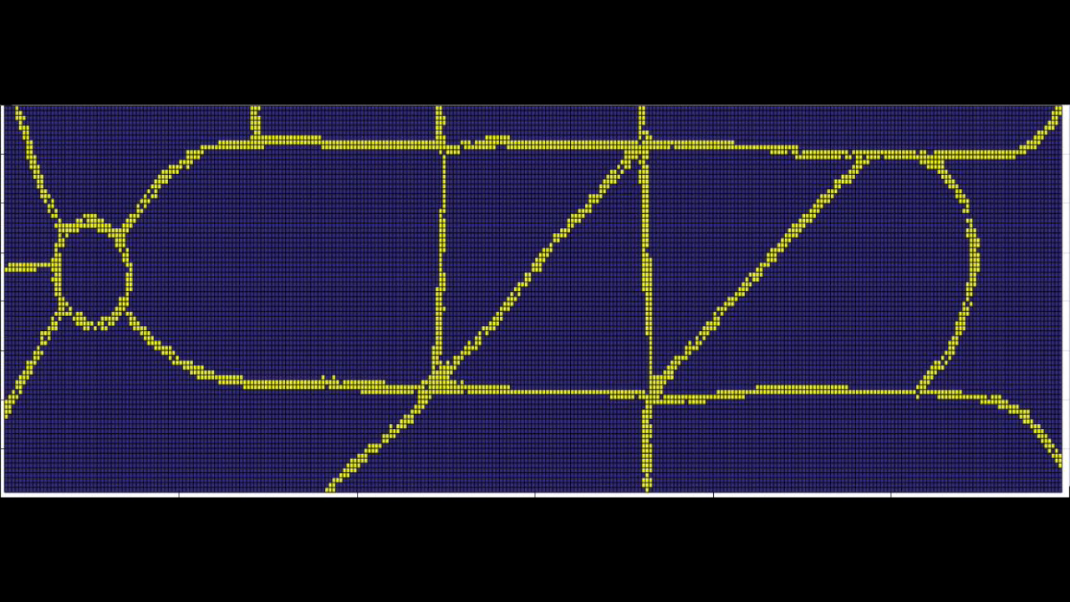
Real Park II: Joyce Park

